Slide 1
Psalm 121 – I will lift up mine eyes unto the hills

Slide 2


© Copyright, Christian Quotation of the Day, 2010. All rights reserved.

Slide 3



Slide 4



Slide 5



Slide 6



Slide 7



Slide 8



Slide 9



Slide 10
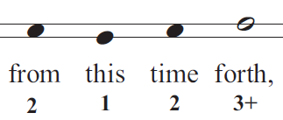


Slide 11


