Slide 1
Psalm 102 –Hear my prayer, O LORD
Text from THE HOLY BIBLE, NEW INTERNATIONAL VERSION®, NIV® Copyright © 1973, 1978, 1984, 2010 by Biblica, Inc.™ Used by permission. All rights reserved worldwide.

Slide 2


© Copyright, Christian Quotation of the Day, 2010. All rights reserved.

Slide 3



Slide 4



Slide 5



Slide 6



Slide 7



Slide 8



Slide 9
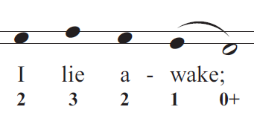


Slide 10



Slide 11



Slide 12



Slide 13



Slide 14



Slide 15
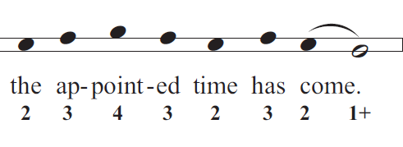

Slide 16



Slide 17



Slide 18



Slide 19



Slide 20



Slide 21



Slide 22



Slide 23



Slide 24



Slide 25



Slide 26



Slide 27



Slide 28



Slide 29



Slide 30
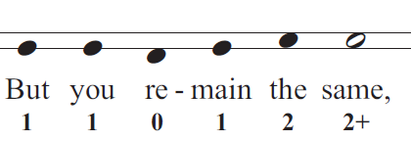


Slide 31



Slide 32
