Slide 1
Psalm 100 –O be joyful in the LORD

Slide 2


© Copyright, Christian Quotation of the Day, 2010. All rights reserved.

Slide 3



Slide 4

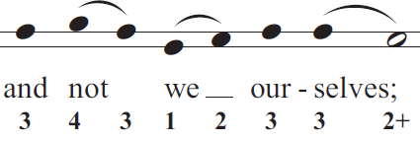

Slide 5



Slide 6



Slide 7

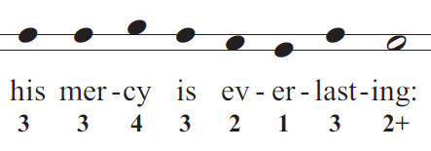

Slide 8



Slide 9
