Slide 1
Psalm 46 – God is our refuge
Text from THE HOLY BIBLE, NEW INTERNATIONAL VERSION®, NIV® Copyright © 1973, 1978, 1984, 2010 by Biblica, Inc.™ Used by permission. All rights reserved worldwide.

Slide 2
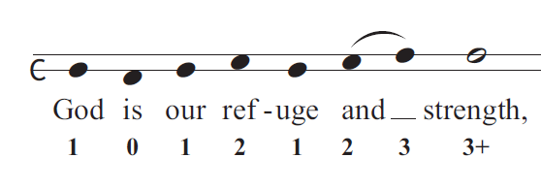
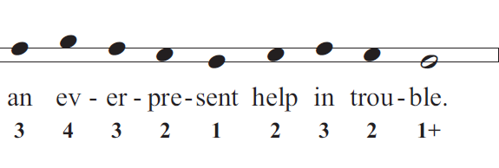
© Copyright, Christian Quotation of the Day, 2010. All rights reserved.

Slide 3
