Slide 1
Psalm 24 –The earth is the LORD’s
Text from THE HOLY BIBLE, NEW INTERNATIONAL VERSION®, NIV® Copyright © 1973, 1978, 1984, 2010 by Biblica, Inc.™ Used by permission. All rights reserved worldwide.

Slide 2


© Copyright, Christian Quotation of the Day, 2010. All rights reserved.

Slide 3



Slide 4



Slide 5



Slide 6


Slide 7



Slide 8



Slide 9



Slide 10



Slide 11



Slide 12



Slide 13



Slide 14
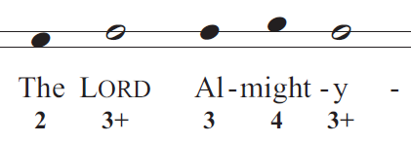


Slide 15
