Slide 1
Psalm 23 – The Lord is my shepherd

Slide 2
© Copyright, Christian Quotation of the Day, 2010. All rights reserved.

Slide 8
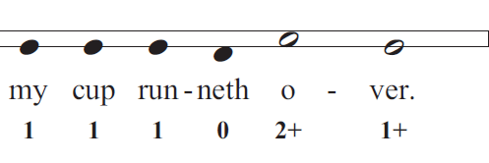

Slide 9
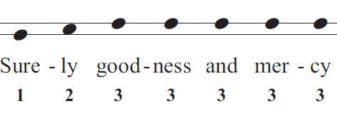

Slide 10
