Slide 1
Psalm 1 — The two ways
Portions from THE HOLY BIBLE, NEW INTERNATIONAL VERSION®, NIV® Copyright © 1973, 1978, 1984, 2010 by Biblica, Inc.™ Used by permission. All rights reserved worldwide.

Slide 2
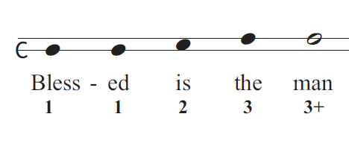
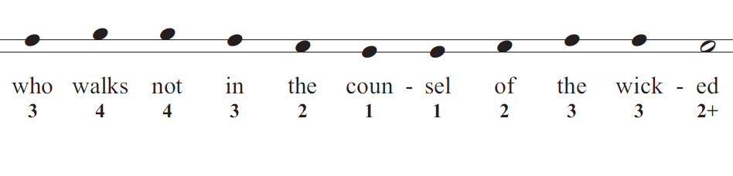
© Copyright, Christian Quotation of the Day, 2010. All rights reserved.

Slide 3
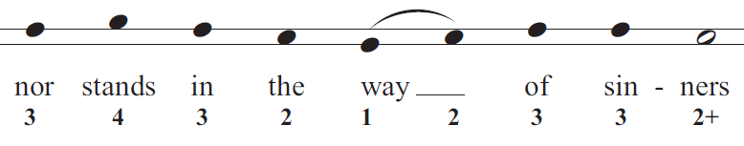
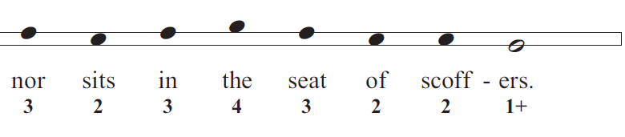

Slide 4
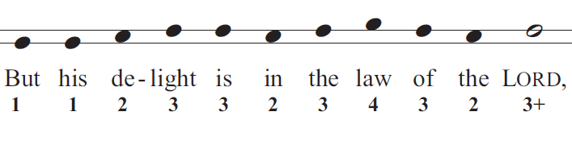
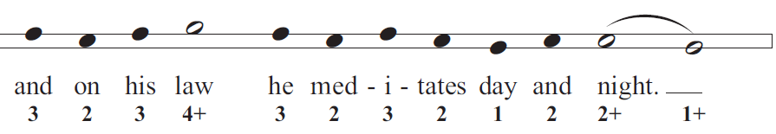

Slide 5
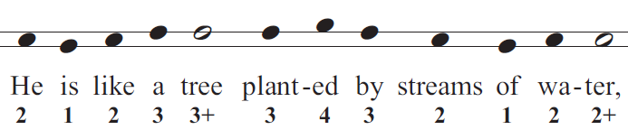
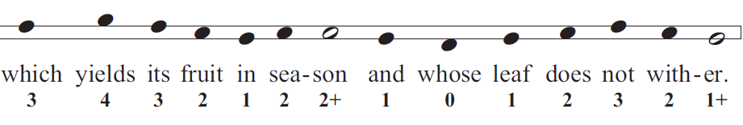

Slide 6
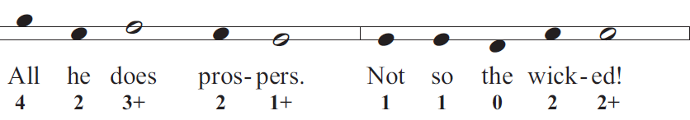
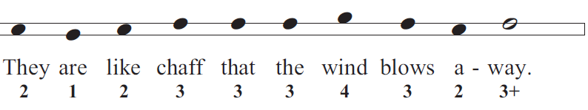

Slide 7
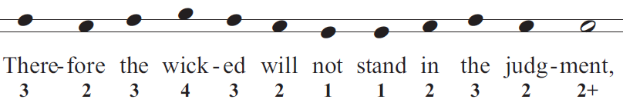
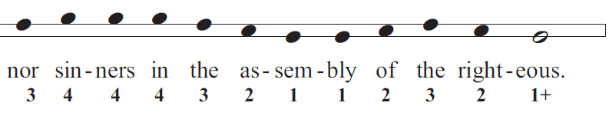

Slide 8
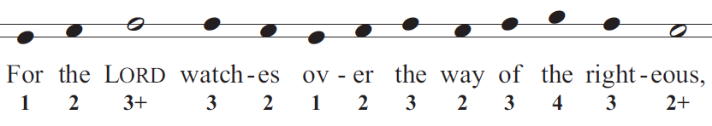
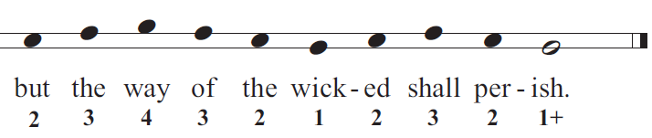

Slide 9
from
Simple Songs for Psalms www.cqod.com/SSP
© Copyright, Christian Quotation of the Day, 2010-2011

